Slide 1
Exception Handling

Slide 2
Content
Displaying custom error pages
Exception Handling
Exercises

Slide 3
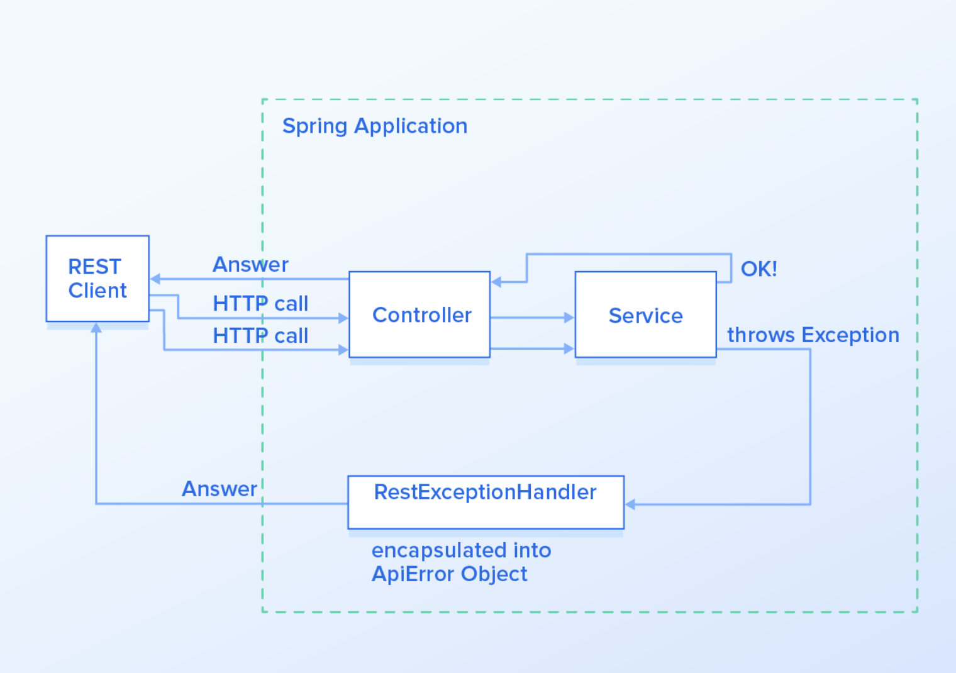
Exception Handling in Spring
https://www.toptal.com/java/spring-boot-rest-api-error-handling

Slide 4
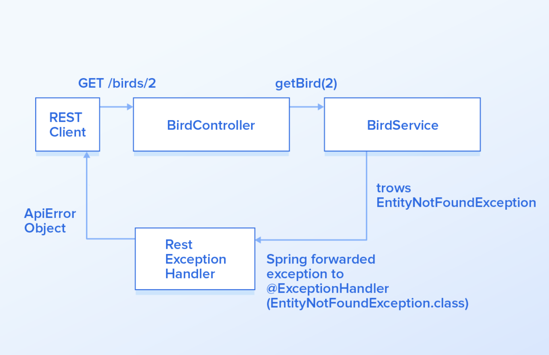
Exception Handling in Spring
https://www.toptal.com/java/spring-boot-rest-api-error-handling

Slide 5
Error Handling for REST
Controller level @ExceptionHandler
HandlerExceptionResolver
DefaultHandlerExceptionResolver
ResponseStatusExceptionResolver
@ControllerAdvice
ResponseStatusException (Spring 5 and Above)

Slide 6
Controller level @ExceptionHandler
@Controller
@RequestMapping(path = "/api/exception")
public class ExceptionController {
@ExceptionHandler({NoSuchElementException.class, JsonMappingException.class})
public ModelAndView handleException(Exception exception) {
ModelAndView modelAndView = new ModelAndView();
modelAndView.setViewName("custom-error");
modelAndView.addObject("message", exception.getMessage());
return modelAndView;
}
}

Slide 7
HandlerExceptionResolver
DefaultHandlerExceptionResolver
This resolver was introduced in Spring 3.0, and it's enabled by default in the DispatcherServlet.
It's used to resolve standard Spring exceptions to their corresponding HTTP Status Codes, namely Client error – 4xx and Server error – 5xx status codes
http://localhost:8080/default-handler-exception-resolver/
https://github.com/nursultanturdaliev/money-transfer-app/commit/de5e8722a4bdd40f19b5336579846d63dad833d4

Slide 8
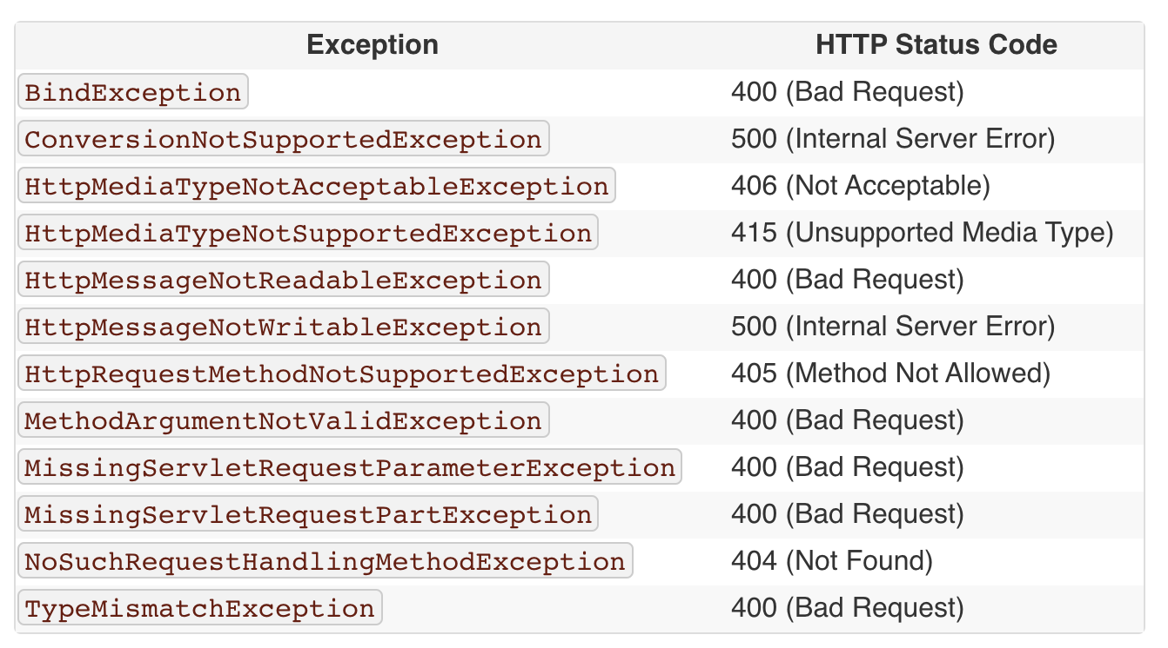
HandlerExceptionResolver: DefaultHandlerExceptionResolver

Slide 9
HandlerExceptionResolver: ResponseStatusExceptionResolver
Its main responsibility is to use the @ResponseStatus annotation available on custom exceptions and to map these exceptions to HTTP status codes.
import org.springframework.http.HttpStatus;
import org.springframework.web.bind.annotation.ResponseStatus;
@ResponseStatus(value = HttpStatus.CONFLICT)
public class UserResourceNotFoundException extends Exception {
public UserResourceNotFoundException() {
super();
}
}
http://localhost:8080/response-status-exception-resolver/
https://github.com/nursultanturdaliev/money-transfer-app/commit/fdcebd27240cc673d7b4cb51a432f481633bdcbf

Slide 10
@ControllerAdvice @ExceptionHandler
@ControllerAdvice
class RestResponseEntityExceptionHandler
extends ResponseEntityExceptionHandler {
@ExceptionHandler(value = {RecordConflictException.class})
public final ResponseEntity<ErrorResponse> handleUserNotFoundException(RecordConflictException ex) {
ArrayList<String> details = new ArrayList<String>();
details.add(ex.getLocalizedMessage());
ErrorResponse error = new ErrorResponse(MoneyTransferAppApplication.RECORD_CONFLICT, details);
return new ResponseEntity<>(error, HttpStatus.CONFLICT);
}
}
http://localhost:8080/controller-advice-exception-handler/ https://github.com/nursultanturdaliev/money-transfer-app/commit/ac409512d9026d2ce1f1fde89250e2f0a4527aeb

Slide 11
@ControllerAdvice Advantages
Full control over the body of the response as well as the status code
Mapping of several exceptions to the same method, to be handled together, and
It makes good use of the newer RESTful ResponseEntity response

Slide 12
ResponseStatusException (Spring 5 and Above)
@Controller
public class ResponseStatusExceptionController {
@GetMapping(path = "/response-status-exception")
public ResponseEntity<String> fetchAll() {
throw new ResponseStatusException(
HttpStatus.BANDWIDTH_LIMIT_EXCEEDED,
"Custom bandwidth limit exceeded reason message");
}
}
http://localhost:8080/response-status-exception
https://github.com/nursultanturdaliev/money-transfer-app/commit/a0269a68b4b746d87cc78fb4efbce181a66a458b

Slide 13
ResponseStatusException Benefits
Excellent for prototyping: We can implement a basic solution quite fast
One type, multiple status codes: One exception type can lead to multiple different responses. This reduces tight coupling compared to the @ExceptionHandler
We won't have to create as many custom exception classes
More control over exception handling since the exceptions can be created programmatically

Slide 14
ResponseStatusException tradeoffs
There's no unified way of exception handling: It's more difficult to enforce some application-wide conventions, as opposed to @ControllerAdvice which provides a global approach
Code duplication: We may find ourselves replicating code in multiple controllers

Slide 15
Spring Boot Default Exception Handling
Sending request with `Accept = text/html,application/xhtml+xml,application/xml;q=0.9,image/webp,image/apng,*/*;q=0.8,application/signed-exchange;v=b3` returns html white label response
Sending api request responds with JSON response body
{
"timestamp": "2019-10-15T20:38:36.010+0000",
"status": 404,
"error": "Not Found",
"message": "No message available",
"path": "/asdf"
}

Slide 16
Spring Boot Configuring
server.error.whitelabel.enabled: can be used to disable the Whitelabel Error Page and rely on the servlet container to provide an HTML error message
server.error.include-stacktrace: with an always value, it includes the stacktrace in both the HTML and the JSON default response

Slide 17
Note
We can implement a @ControllerAdvice globally, but also ResponseStatusExceptions locally. However, we need to be careful: If the same exception can be handled in multiple ways, we may notice some surprising behavior. A possible convention is to handle one specific kind of exception always in one way.

Slide 18
Exercises
Remove not found responses from user endpoints and handle using exception handling
Handle JsonMappingException using @ExceptionHandler on user update endpoint
Handle EmptyResultDataAccessException using @ControllerAdvice

Slide 19
References
https://www.baeldung.com/exception-handling-for-rest-with-spring
https://www.baeldung.com/spring-boot-logging
https://howtodoinjava.com/spring-core/spring-exceptionhandler-annotation/
https://www.baeldung.com/spring-boot-custom-error-page
https://howtodoinjava.com/spring-core/spring-exceptionhandler-annotation/
https://www.baeldung.com/spring-response-status-exception
https://spring.io/blog/2013/11/01/exception-handling-in-spring-mvc
https://www.toptal.com/java/spring-boot-rest-api-error-handling

